Slide 1
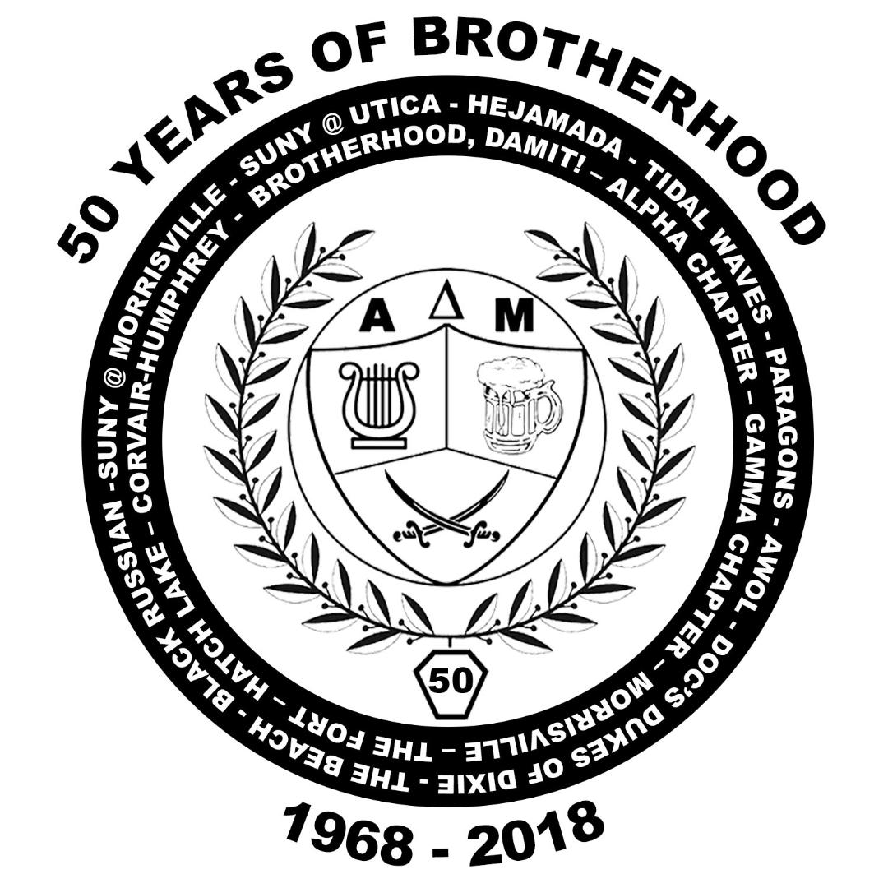
Alpha Delta Mu Alumni Association
John F Humphrey
Memorial Scholarship

Slide 2
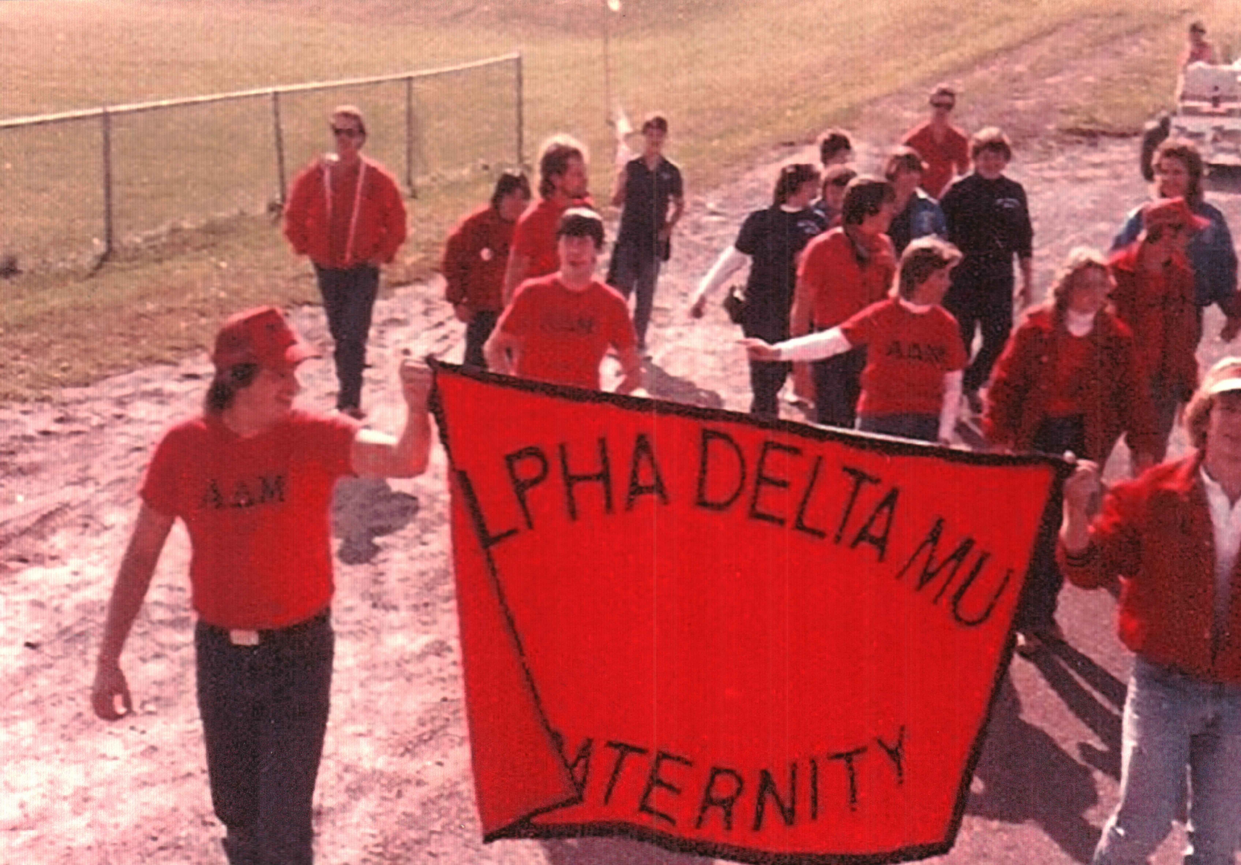
History of the Fraternity
National Fraternity
The Fraternity was founded in 1968 to bind together all the college students at Morrisville who have an interest in music. Over the years, the fraternity has played a key role in broadening the brother’s knowledge of, and interest in the field of music and its future.
Although the support and strengthening of Morrisville’s music department is the main objective of the fraternity, the brothers enjoy a number of social activities. With the assistance of some of the most active alumni of any organization on campus, the fraternity dinners and annual summer camping trip proved to be the most festive and enjoyable activities during the year.
As well as the learning experience and fun activities, Alpha Delta Mu was also committed to community service. Heeding requests from administration, student government and local civic organizations, the brothers had been seen aiding the Red Cross in blood drives, running a fund raising booth on parents weekend and sponsoring top name musicians for the annual Jazz festival.

Slide 3
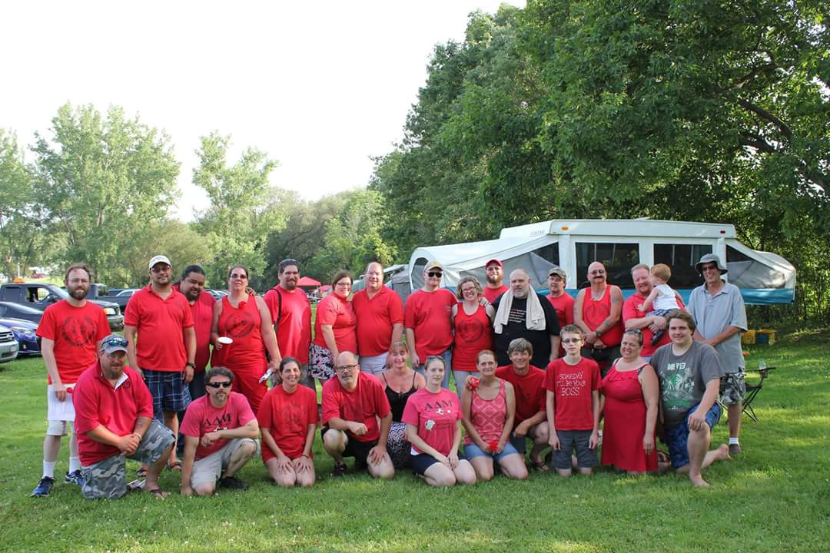
Progression of the Alumni Association
By the late 1980’s, the need had arisen to organize the numerous graduates so that their efforts would have a common direction and goal. The Alpha Delta Mu Alumni Organization was founded on January 31, 1987.
It’s purpose is to maintain an organized alumni group, establish stable interaction between the alumni and active members, establish funds, promote social and business contacts between alumni brothers and maintain an ongoing search for "lost" brothers.
The Alumni Association is a strong, active organization. The Association holds numerous meetings each year and attends many activities promoted by SUNY Morrisville and the Alpha Delta Mu Fraternity.
Music has always been an important part of Alpha Delta Mu. We would not be where we are today without the music or the man who brought us together.

Slide 4
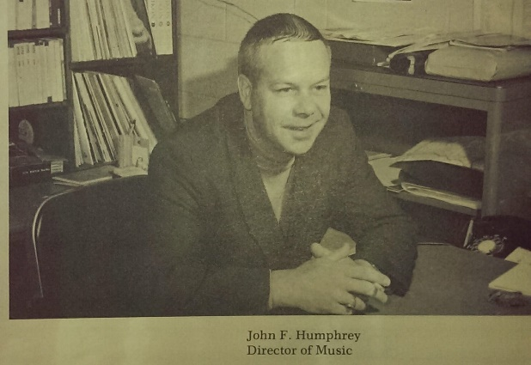
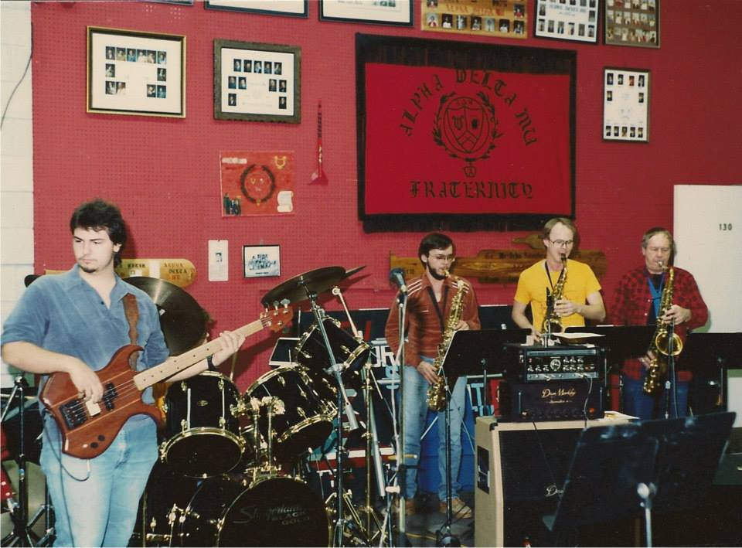
Our Founder
John F. Humphrey was more than a teacher or founder of Alpha Delta Mu. To all of us he was a brother, to some, a teacher and a few, a father.
The music came to SUNY Morrisville in 1964 when a young man fresh out of college was hired to teach music at SUNY Morrisville. Known to everyone as "Doc, in the 33 years he taught at Morrisville, he became a legend in his own right.
Many of Morrisville’s instructors and graduates can recall performing with Doc in the College Orchestra, the College Choir, Musicals, AWOL, Cathedral, Paragons and Skylarks.
Within five years he helped start a concert band, the Paragons Jazz Band and a choir.. He arranged for Morrisville appearances by music greats. Humphrey formed the New York State Intercollegiate Jazz Festival, which brought top jazz talent to the Morrisville campus such as Buddy Rich, Stan Kenton, Maynard Ferguson and Count Basie..
In 1968 Doc gathered a number of students and established the Alpha Delta Mu Music Fraternity at SUNY Morrisville.
In an Alumni News interview at the time of his retirement in 1995. Doc admitted that when he came to Morrisville, he didn't anticipate staying so long. For those of us who knew him, we know he wouldn't have considered teaching anywhere else. Doc and music at SUNY Morrisville will always be synonymous. Whether you ever touched a musical instrument; if you ever passed through Morrisville, you were certainly touched by Doc.
Doc passed away after suffering a massive heart attack. He was 67 years old. We were all heartbroken and decided the best way to perpetuate our love of him and the music was to create this scholarship fund.
"I loved my job. Students are important to me." Doc was quoted as saying .

Slide 5
To honor John “Doc” Humphrey for all the time, friendship, and love he gave us, Alpha Delta Mu, his family and fiends have established this scholarship in his name.
Award:
One scholarship will be awarded annually for one year (2 semesters) of full time study attending SUNY Morrisville at the Morrisville campus. The scholarship will be awarded to one person a year and distributed each fall and spring semester in the amount of $450.
Eligibility:
The applicant must be registered as a full time student at SUNY Morrisville.
The applicant must be taking classes at the Morrisville Campus.
The applicant cannot be a member or a relative of a member of the Alpha Delta Mu Fraternity
Method of Application and Due Date:
Be Sure to Include:
Application Form for the John F. “Doc” Humphrey Scholarship
High School Transcript for in coming freshmen or Collage transcripts for existing students.
Personal Essay Form

